Slide 1
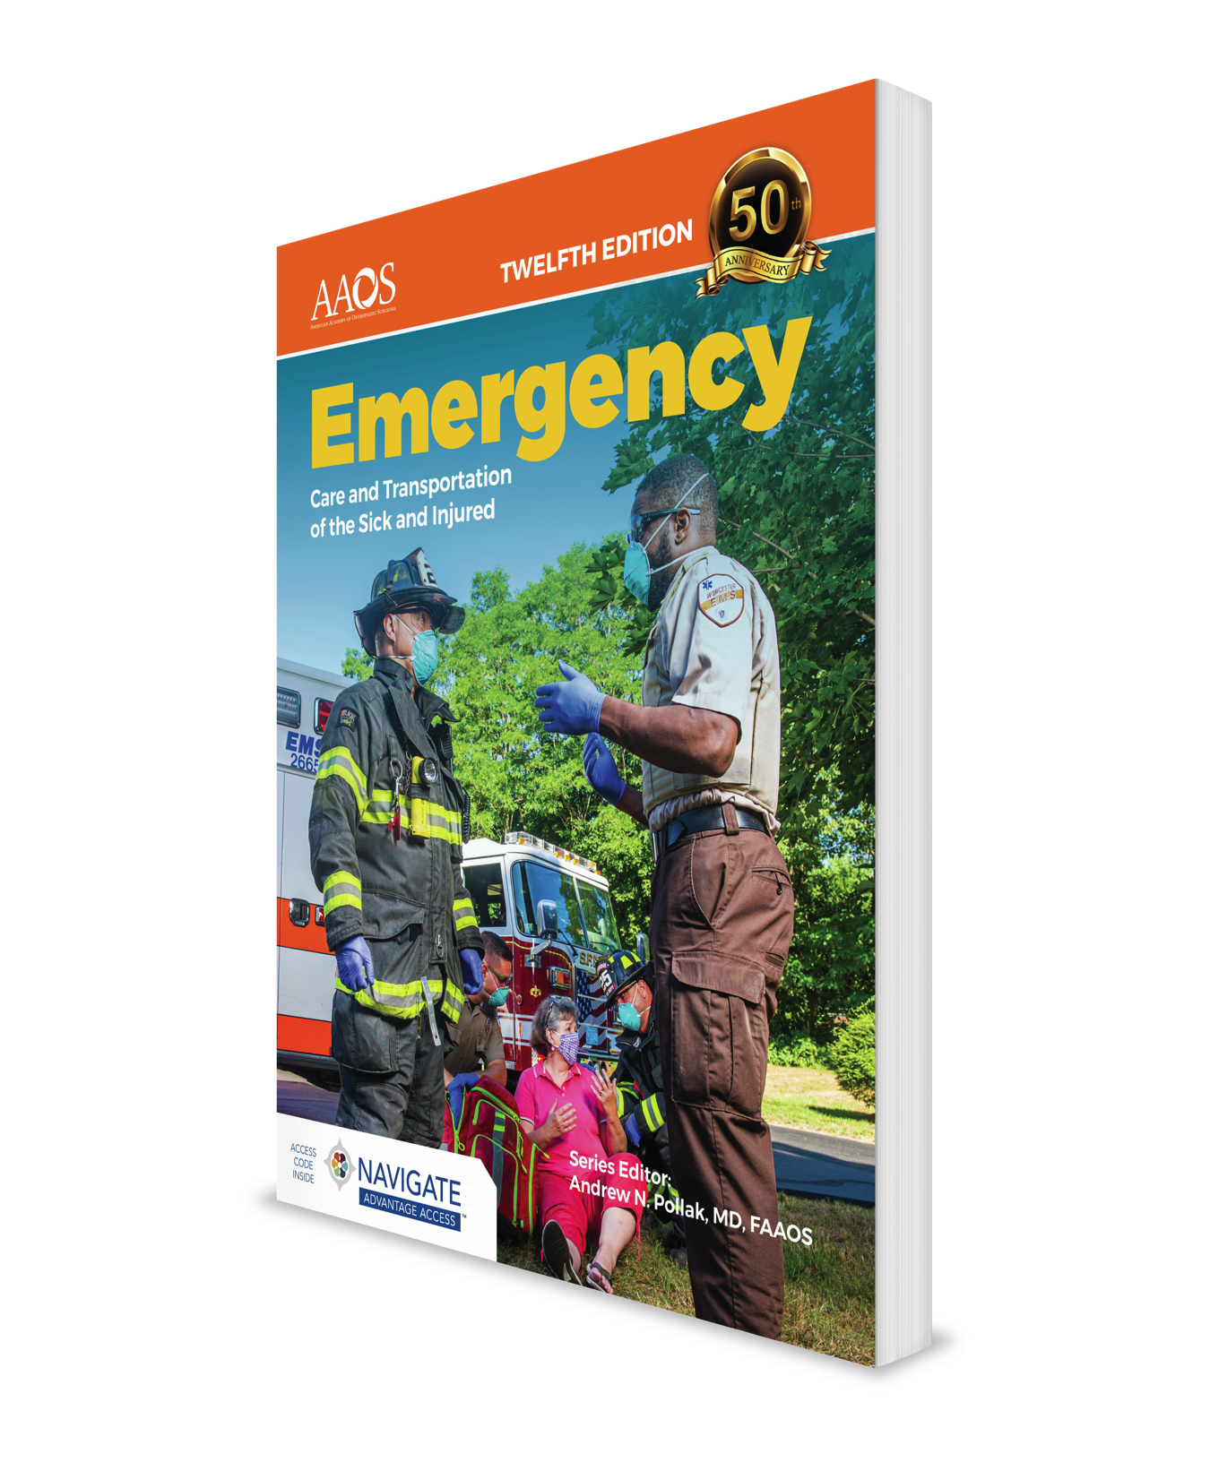
Principles of Pharmacology
CHAPTER 12

Slide 2
National EMS Education Standard Competencies (1 of 5)
Pharmacology
Applies fundamental knowledge of the medications that the EMT may assist/administer to a patient during an emergency.
Notes:
National EMS Education Standard Competencies
Pharmacology
Applies fundamental knowledge of the medications that the EMT may assist/administer to a patient during an emergency.

Slide 3
National EMS Education Standard Competencies (2 of 5)
Principles of Pharmacology
Medication safety
Kinds of medications used during an emergency
Notes:
National EMS Education Standard Competencies
Principles of Pharmacology
• Medication safety
• Kinds of medications used during an emergency

Slide 4
National EMS Education Standard Competencies (3 of 5)
Medication Administration
Self-administer medication
Peer-administer medication
Assist/administer medication to a patient
Notes:
National EMS Education Standard Competencies
Medication Administration
• Self-administer medication
• Peer-administer medication
• Assist/administer medications to a patient

Slide 5
National EMS Education Standard Competencies (4 of 5)
Emergency Medications
Names
Effects
Actions
Indications
Contraindications
Notes:
National EMS Education Standard Competencies
Emergency Medications
• Names
• Effects
• Actions
• Indications
• Contraindications

Slide 6
National EMS Education Standard Competencies (5 of 5)
Emergency Medications (cont’d)
Complications
Routes of administration
Side effects
Interactions
Dosages for the medications administered
Notes:
National EMS Education Standard Competencies
• Complications
• Routes of administration
• Side effects
• Interactions
• Dosages for the medications administered

Slide 7
Introduction
Medications are an important intervention.
Medications may alleviate pain and improve the patient’s condition.
Failure to administer medications safely and competently can lead to serious consequences for the patient, including death.
Notes:
Lecture Outline
I. Introduction
A. Medications are an important intervention available to you as an EMT.
B. Used appropriately, medications may alleviate pain and improve a patient’s condition.
C. Failure to administer medications safely and competently can lead to serious consequences for the patient, including death.

Slide 8
How Medications Work (1 of 5)
Pharmacology is the science of drugs.
A medication is a substance used to:
  Prevent or treat disease
  Relieve pain
Pharmacodynamics is a process by which medication works on the body.
Notes:
Lecture Outline
II. How Medications Work
A. Medical definitions
1. Pharmacology: the science of drugs, including their ingredients, preparation, uses, and actions on the body
2. Medication: a substance used to treat or prevent disease or relieve pain
3. Pharmacodynamics: the process by which medication works on the body
a. A medication can either produce an effect or block the receptors to prevent other chemicals or medications from binding.

Slide 9
How Medications Work (2 of 5)
Agonist: causes stimulation of receptors
Antagonist: binds to a receptor and blocks other medications or chemicals
Dose: amount of medication given
Action: the therapeutic effect that a medication is expected to have on the body
Notes:
Lecture Outline
4. Agonist: medication that causes stimulation of receptors
5. Antagonist: medication that binds to a receptor and blocks other medications or chemicals from attaching
6. Dose: the amount of the medication that is given, which depends on:
a. Patient’s weight
b. Patient’s age
c. Desired action of the medication
7. Action: the therapeutic effect that a medication is expected to have on the body

Slide 10
How Medications Work (3 of 5)
Pharmacokinetics: actions of the body upon the medication or chemical
  Onset of action
  Duration
  Elimination
  Peak
Notes:
Lecture Outline
8. Pharmacokinetics: actions of the body upon the medication (or chemical)
a. Onset of action: time from medication administration until clinical effects occur.
b. Duration: length of time that clinical effects persist.
c. Elimination: how medications or chemicals are removed from the body.
d. Peak: the point or period when the maximum clinical effect is achieved.

Slide 11
How Medications Work (4 of 5)
Factors affecting how a medication works:
  Route of administration
  Shock states
Notes:
Lecture Outline
9. Factors affecting how a medication works:
a. Route of administration
b. Shock states

Slide 12
How Medications Work (5 of 5)
Indications: reasons or conditions
Contraindications: harmful effects
  Absolute
  Relative
Adverse effects
  Unintended effects
  Untoward effects
Notes:
Lecture Outline
10. Indications: reasons or conditions for which a particular medication is given
11. Contraindications: situations in which a medication would either harm the patient or have no positive effect
a. Absolute contraindications: situations in which a medication should never be given if the contraindication is present
b. Relative contraindications: situations in which the benefits of administering the drug may outweigh the risks
12. Adverse effects: any actions of a medication other than the desired ones
a. Unintended effects: effects that are undesirable but pose little risk to the patient
b. Untoward effects: effects that can be harmful to the patient

Slide 13
Medication Names (1 of 2)
Generic name: a simple, clear, nonproprietary name
  Example: ibuprofen
Trade name: manufacturer’s brand name
  One drug may have more than one trade name.
  Example: Tylenol
Notes:
Lecture Outline
B. Medication names
1. The generic name is a simple, clear, nonproprietary name.
a. Generic names are not capitalized.
2. The trade name is the brand name that a manufacturer gives to a drug.
a. Trade names begin with a capital letter.
b. One drug may have more than one trade name.

Slide 14
Medication Names (2 of 2)
Prescription medications
Over-the-counter (OTC) medications
Recreational drugs
Herbal remedies
Enhancement drugs
Vitamin supplements
Alternative medicines
Notes:
Lecture Outline
3. Prescription drugs are distributed only by pharmacists and require a physician’s order.
4. Over-the-counter (OTC) drugs may be purchased directly without a prescription.
5. Other kinds of drugs
a. Recreational drugs (eg, heroin, cocaine)
b. Herbal remedies
c. Enhancement drugs
d. Vitamin supplements
e. Alternative medicines
6. Any medication that a patient takes can be pharmacologically active and can cause an effect, so ask patients about any and all medications or drugs they are taking.

Slide 15
Routes of Administration (1 of 5)
Enteral medications enter the body through the digestive system.
Parenteral medications enter the body by some other means.
Notes:
Lecture Outline
C. Routes of administration
1. Enteral medications enter the body through the digestive system.
a. Often in pill or liquid form such as cough medicine
b. Medications administered via this route tend to be absorbed slowly and are not commonly used in an emergency setting.
2. Parenteral medications enter the body by some other means.
a. Often in liquid form administered through needles or syringes
b. Absorbed more quickly and offer a more predictable and measurable response

Slide 16
Routes of Administration (2 of 5)
Absorption is the process by which medications travel through body tissues to the bloodstream.
Common routes of administration:
  Per rectum (PR): by rectum
  Oral or per os (PO): by mouth
Notes:
Lecture Outline
3. Absorption: the process by which medications travel through body tissues to the bloodstream
4. Common routes of administration
a. Per rectum (PR)
i. “By rectum”
ii. Easy to administer; provides reliable absorption
b. Oral (PO)
i. “By mouth”
ii. Takes as long as 1 hour for absorption to occur

Slide 17
Routes of Administration (3 of 5)
Common routes of administration (cont’d):
  Intravenous (IV): into the vein
  Intraosseous (IO): into the bone
  Subcutaneous (SC): beneath the skin
  Intramuscular (IM): into the muscle
Notes:
Lecture Outline
c. Intravenous (IV) injection
i. “Into the vein”
ii. Fastest delivery but cannot be used for all medications
d. Intraosseous (IO) injection
i. “Into the bone”
ii. Reaches the bloodstream through the bone marrow
iii. Requires drilling a needle into the outer layer of bone
e. Subcutaneous (SC) injection
i. “Beneath the skin”
ii. Injection given into the fatty tissue between the skin and muscle
f. Intramuscular (IM) injection
i. “Into the muscle”
ii. Usually absorbed quickly
iii. Not all medications can be administered by the IM route.

Slide 18
Routes of Administration (4 of 5)
Common routes of administration (cont’d):
  Inhalation: inhaled into the lungs
  Sublingual (SL): under the tongue
  Transcutaneous (transdermal): through the skin
  Intranasal (IN): into the nostril via a mucosal atomizer device
Notes:
Lecture Outline
Inhalation
i. Breathed into the lungs
ii. Absorbed into the bloodstream quickly
iii. Forms include aerosols, fine powders, and sprays
h. Sublingual (SL)
i. “Under the tongue”
ii. Enters through the oral mucosa under the tongue and is absorbed into the bloodstream within minutes
i. Transcutaneous (transdermal)
i. “Through the skin”
ii. Applied as a patch to the skin
iii. Longer-lasting effect than other routes
j. Intranasal (IN)
i. Relatively new format for the delivery of medication
ii. Medication is pushed through a mucosal atomizer device (MAD) that aerosolizes the liquid for delivery into the nostril.
iii. Quick absorption

Slide 19
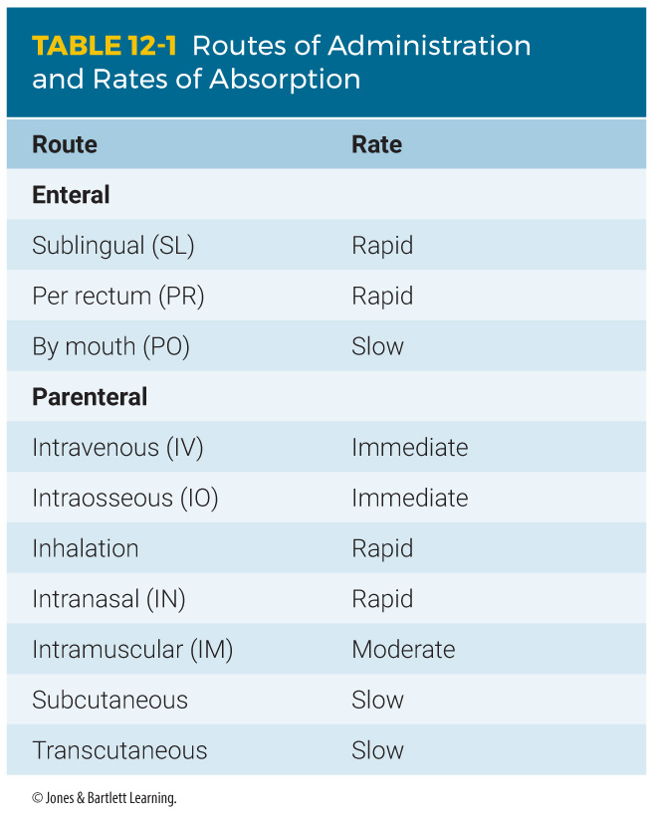
Routes of Administration (5 of 5)
Notes:
Table 12-1 lists common routes of medication administration and rates of absorption.

Slide 20
Medication Forms
The form of medication usually dictates the route of administration.
The manufacturer chooses the form to ensure:
  Proper route of administration
  Timing of the medication’s release into the bloodstream
  Effects on the target organs or body systems
Notes:
Lecture Outline
III. Medication Forms
A. The form of a medication usually dictates the route of administration.
1. The manufacturer chooses the form to ensure:
a. Proper route of administration
b. Timing of the medication’s release into the bloodstream
c. Effects on the target organs or body systems

Slide 21
Tablets and Capsules
Capsules are gelatin shells filled with powdered or liquid medication.
Tablets often contain other materials that are mixed with the medication and compressed.
Notes:
Lecture Outline
B. Tablets and capsules
1. Most medications given by mouth are in tablet or capsule form.
2. Capsules are gelatin shells filled with powder or liquid medication.
3. Tablets often contain other materials that are mixed with the medication and compressed.

Slide 22
Solutions and Suspensions
A solution is a liquid mixture of substances.
  Will not separate by filtering or letting it stand
  Can be given as an IV, IM, or SC injection
A suspension is substance that does not dissolve well in liquids.
  Will separate if it stands or is filtered.
Notes:
Lecture Outline
C. Solutions and suspensions
1. A solution is a liquid mixture of one or more substances that cannot be separated simply.
2. Solutions can be given by almost any route.
a. When given by mouth, solutions may be absorbed from the stomach fairly quickly because the medication is already dissolved
b. Many solutions can be given as an IV, IM, or SC injection.
3. A suspension is a mixture of finely ground particles that are distributed evenly throughout a liquid by shaking or stirring but do not dissolve.
a. Suspensions separate if they stand or are filtered.
b. It is important to shake or swirl a suspension before its administration

Slide 23
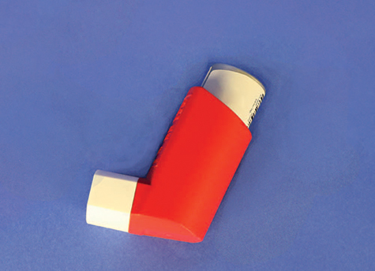
Metered-Dose Inhalers
Liquids or solids broken into small enough droplets or particles may be inhaled.
A metered-dose inhaler (MDI) directs such substances through mouth into lungs.
Delivers the same amount each time
FIGURE 12-2 Some medications are inhaled into the lungs with a metered-dose inhaler so that they can be absorbed into the bloodstream near the site of desired action more quickly.
© Jones & Bartlett Learning.
Notes:
Lecture Outline
D. Metered-dose inhalers
1. Liquids or solids that are broken into small enough droplets or particles may be inhaled.
2. Spray canister directs such substances through the mouth and into the lungs.
3. Delivers the same amount of medication each time it is used
4. Often used for respiratory illnesses such as asthma or emphysema

Slide 24
Topical Medications
Include lotions, creams, and ointments
Applied to skin surface and affect only that area
Examples
  Lotion: calamine lotion
  Cream: hydrocortisone cream
  Ointment: Neosporin ointment
Notes:
Lecture Outline
E. Topical medications
1. Include lotions, creams, and ointments
2. Applied to the skin surface and affect only that area

Slide 25
Transcutaneous Medications
Designed to be absorbed through the skin
Also referred to as transdermal
May have systemic effects
If you touch the medication with your skin, you will absorb it just like the patient.
Notes:
Lecture Outline
F. Transcutaneous medications
1. Also referred to as transdermal medications
2. Absorbed through the skin
3. Many transdermal medications have systemic (whole-body) effects
4. If you touch the medication with your skin, you will absorb it just like the patient.

Slide 26
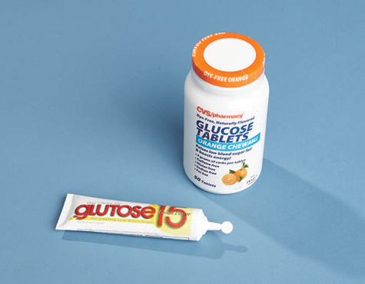
Gels
Semiliquid
Administered in capsules or through plastic tubes
Example: oral glucose for patient with diabetes
FIGURE 12-4 Oral glucose, used in diabetic emergencies, is available in gel and tablet forms.
© Jones & Bartlett Learning.
Notes:
Lecture Outline
G. Gels
1. Semiliquid
2. Administered in capsules or through plastic tubes

Slide 27
Gases for Inhalation
Usually delivered through a nonrebreathing mask or nasal cannula
Outside the operating room, most commonly used is oxygen
Notes:
Lecture Outline
H. Gases for inhalation
1. Usually delivered through a nonrebreathing mask or nasal cannula
2. Oxygen is the medication most commonly used in gas form outside the operating room.

Slide 28
General Steps in Administering Medication (1 of 2)
Medications should be administered only under the authorization of medical control.
Follow the “rights” of medication administration.
Medication errors almost always result from failure to follow these “rights.”
Notes:
Lecture Outline
IV. General Steps in Administering Medication
A. Medications should be administered only under the authorization of online or off-line medical direction.
Follow the “rights.”
1. Right patient: Ensure that the patient who needs the medication is the person who receives the medication.
2. Right medication and indication: Verify the proper medication and prescription.
3. Right dose: Verify the form and dose of the medication.
4. Right route: Verify the route of the medication.
5. Right time: Check the expiration date and condition of the medication.
6. Right education: Inform the patient of the medication you intend to administer, including any likely adverse effects or unusual sensations he or she may experience.
7. Right to refuse: Patients with decision-making capacity can decline or refuse proposed interventions or medications.
8. Right response and evaluation: Monitor the patient’s vital signs, mental status, signs of perfusion, and respiratory effort after medication administration. Assess for the anticipated response, and observe for any adverse medication effects.
9. Right documentation: Document your actions and the patient’s response.
C. Medication Administration Cross-Check and Procedure
1. Using a verbal cross-check procedure that verifies you are giving the right drug to the right patient at the right dose has been found to reduce medication errors.

Slide 29
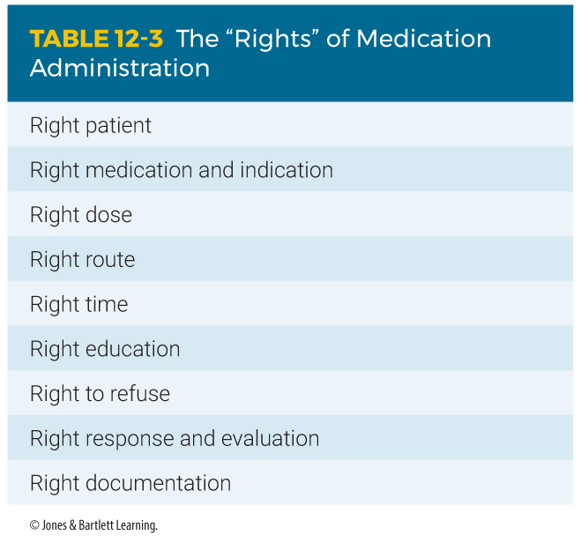
General Steps in Administering Medication (2 of 2)
Notes:
Lecture Outline
1. Right patient: Ensure that the patient who needs the medication is the person who receives the medication.
2. Right medication and indication: Verify the proper medication and prescription.
3. Right dose: Verify the form and dose of the medication.
4. Right route: Verify the route of the medication.
5. Right time: Check the expiration date and condition of the medication.
6. Right education: Inform the patient of the medication you intend to administer, including any likely adverse effects or unusual sensations he or she may experience.
7. Right to refuse: Patients with decision-making capacity can decline or refuse proposed interventions or medications.
8. Right response and evaluation: Monitor the patient’s vital signs, mental status, signs of perfusion, and respiratory effort after medication administration. Assess for the anticipated response, and observe for any adverse medication effects.
9. Right documentation: Document your actions and the patient’s response.

Slide 30
Medication Administration and the EMT
Circumstances in which medications may be administered:
  Peer-assisted administration
  Patient-assisted administration
  EMT-administered medications
Determined by:
  State and local protocols
  Medical control
Notes:
Lecture Outline
A. Over the years, EMTs have been allowed increasing responsibility to work with medications.
B. Many departments have strict guidelines on when an EMT is allowed to administer a medication.
1. Peer-assisted medication
a. You administer medication to yourself or your partner.
b. Example: You were exposed to a toxic agent.
2. Patient-assisted medication
a. You assist the patient with administering his or her own medication.
b. Examples: epinephrine auto-injector, nitroglycerin, metered-dose inhaler
3. EMT-administered medication
a. The EMT directly administers the medication to the patient.
b. The patient may be severely confused or unable to understand the need for the medication.
c. Examples: oxygen, oral glucose, aspirin
C. Medical control, state guidelines, and local protocols determine what an EMT in your system may administer.
1. Refer to your local standards to obtain a listing of how and when EMTs can administer medications.

Slide 31
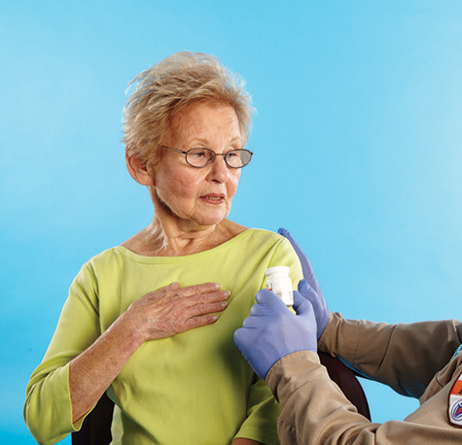
Oral Medications (1 of 3)
Confirm that the patient has a patent airway and is able to swallow, and then instruct the patient to swallow or chew the medication.
FIGURE 12-6 Instruct the patient to chew
(eg, baby aspirin) or swallow the medication.
© Jones & Bartlett Learning.
Notes:
Lecture Outline
A. Oral medications
1. Follow the following steps to perform oral medications:
a. Take standard precautions
b. Confirm the medication is not expired
c. Obtain medical direction per local protocol.
d. Confirm that the patient has a patent airway and is able to swallow or chew the medication.
e. Monitor the patient’s condition and document.

Slide 32
Oral Medications (2 of 3)
Oral glucose
  A sugar that cells use for energy
  Treats hypoglycemia
  EMTs give it only by mouth.
  Do not give to an unconscious patient or one who cannot protect the airway.
Notes:
Lecture Outline
2. Oral glucose
a. Glucose is a sugar that cells use for energy; it is necessary for brain cells’ survival.
b. Hypoglycemia: extremely low blood glucose
c. Oral glucose can counteract the effects of hypoglycemia.
d. An EMT can give glucose only by mouth in the form of a gel
e. Never administer oral medications to an unconscious patient or to one who is unable to swallow or protect the airway.

Slide 33
Oral Medications (3 of 3)
Aspirin
  Reduces fever, pain, and inflammation
  Inhibits platelet aggregation
    Useful during heart attack
  Contraindications
    Hypersensitivity to aspirin
    Liver damage, bleeding disorder, asthma
    Should not be given to children
Notes:
Lecture Outline
3. Aspirin
a. Reduces fever, pain, and inflammation
b. Inhibits platelet aggregation (clumping), which is useful during a potential heart attack
c. Contraindications
i. Hypersensitivity to aspirin
ii. Preexisting liver damage, bleeding disorders, and asthma
iii. Should not be given to children

Slide 34
Sublingual Medications (1 of 5)
Advantages
  Easy to advise patients
  Quick absorption
Disadvantages
  Constant evaluation of the airway
  Possible choking
  Not for uncooperative or unconscious patients
Notes:
Lecture Outline
B. Sublingual medications
1. Considerations
a. Advantages
i. Easy to talk with awake and alert patients and advise them to place a pill under their tongue
ii. Absorption rates are relatively quick.
b. Disadvantages
i. Any medication placed in the mouth requires constant evaluation of the airway.
ii. Should not be used if the patient is uncooperative or unconscious

Slide 35
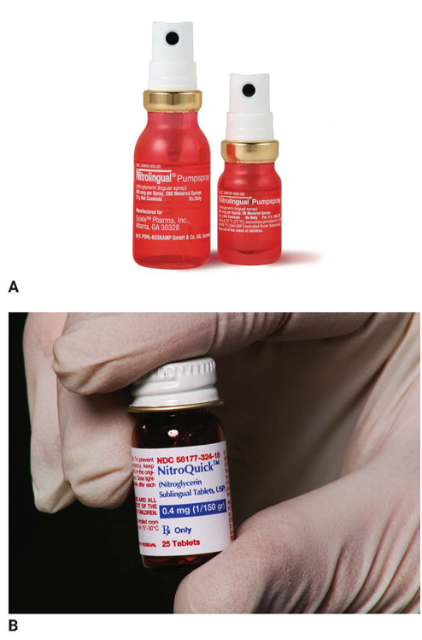
Sublingual Medications (2 of 5)
Nitroglycerin
  Relieves angina pain (cardiac patients)
  Increases blood flow
  Relaxes veins
FIGURE 12-7 Nitroglycerin, which is prescribed for chest pain, can be given sublingually as a spray (A) or tablet (B).
A: Courtesy of Shionogi Pharma, Inc.; B: © Jones & Bartlett Learning.
Notes:
Lecture Outline
2. Nitroglycerin
a. Many cardiac patients carry fast-acting nitroglycerin to relieve angina pain.
b. Increases blood flow by relieving the spasms and causes arteries to dilate by relaxing muscles of coronary arteries and veins.
c. Also relaxes veins throughout the body so that less blood is returned to the heart, decreasing workload and blood pressure.

Slide 36
Sublingual Medications (3 of 5)
Nitroglycerin (cont’d)
  Before administering:
    Check blood pressure.
    Obtain order to administer.
  Possibility of MI, if no relief
  Should not be used with erectile dysfunction medications
  May cause mild headache
Notes:
Lecture Outline
d. Before administration:
i. Check blood pressure before administering nitroglycerin.
ii. Obtain orders or follow your local protocol to administer nitroglycerin.
e. Can have potentially fatal interactions with erectile dysfunction (ED) medications taken within the past 24 hours:
i. Sildenafil (Viagra)
ii. Tadalafil (Cialis)
iii. Vardenafil (Levitra)
iv. Drugs for erectile dysfunction may be used by both men and women.

Slide 37
Sublingual Medications (4 of 5)
Nitroglycerin (cont’d)
  Administration by tablet
    Sublingually under the tongue
    Slight tingling or burning
    Storage is important.
  Administration by metered-dose spray
    On or under tongue
    One spray = one tablet
Notes:
Lecture Outline
f. Administration by tablet
i. Place the tablet under the tongue, where it dissolves.
ii. The patient should experience a slight tingling or burning sensation.
iii. Nitroglycerin should be stored in its original glass container with the cap screwed on tightly.
g. Administration by metered-dose spray
i. Deposits medication on or under the tongue
ii. One spray equals one tablet.

Slide 38
Sublingual Medications (5 of 5)
Administration considerations (for both tablet and spray):
  Wait 5 minutes before repeating dose.
  Monitor vital signs.
  Wear gloves.
  Know local protocols.
Notes:
Lecture Outline
i. Administration considerations (for both tablet and spray)
i. Wait 5 minutes for a response before repeating the dose.
ii. Closely monitor the patient’s vital signs, particularly the blood pressure.
iii. Give repeated doses per medical control and/or local protocol.
iv. Always wear gloves (the medication can be absorbed by your skin).
v. Reconfirm if the medication is still indicated for the patient.
vi. Know and understand local protocols.

Slide 39
Intramuscular Medications (1 of 4)
Advantages
  Quick, easy access without using vein
  Stable blood flow to muscles
Disadvantages
  Use of a needle (and subsequent pain)
  Patients may fear pain or injury.
Notes:
Lecture Outline
C. Intramuscular medications
1. Considerations
a. Advantages
i. Provides quick and easy access to the circulatory system without the need for placing a needle within a vein
ii. Blood flow to the muscles is relatively stable even during circumstances of severe illness or injury.
b. Disadvantages
i. Use of a needle (and subsequent pain)

Slide 40
Intramuscular Medications (2 of 4)
Epinephrine
  Controls fight-or-flight response
  Primary medication for delivery IM
  Also called adrenaline, released inside the body under stress
  Sympathomimetic
Notes:
Lecture Outline
Epinephrine (adrenaline)
a. Also known as adrenaline
b. Released inside the body when there is sudden stress
c. Main hormone that controls the body’s fight-or-flight response

Slide 41
Intramuscular Medications (3 of 4)
Epinephrine (cont’d)
  Increases heart rate and constricts blood vessels
  Do not give to patients with hypertension, hypothermia, MI, or wheezing.
  May be delivered with an auto-injector to treat life-threatening anaphylaxis
Notes:
Lecture Outline
d. Characteristics
i. Secreted naturally by the adrenal glands
ii. Dilates passages in the lungs
iii. Constricts blood vessels, causing increased blood pressure
iv. Increases heart rate and blood pressure
e. Should be given only to patients who are experiencing a life-threatening allergic reaction.
i. Epinephrine may be dispensed from an auto-injector.
ii. Automatically delivers a preset amount of the medication (usually 0.3 mg)
iii. Some services do not permit EMTs to carry epinephrine but do allow them to assist patients in administering their own epinephrine.

Slide 42
Intramuscular Medications (4 of 4)
Naloxone
  Used to reverse the effects of an opioid overdose
  Important considerations:
    Consult medical direction.
    Effects may not last as long as opioids; repeated doses may be necessary
    Can cause severe withdrawal symptoms
    Consider your safety.
Notes:
Lecture Outline
3. Naloxone
a. Used to reverse the effects of an opioid overdose
b. Can be administered by family members or caregivers
c. Considerations:
i. Follow local protocol.
ii. Find out if naloxone has been administered by a bystander prior to your arrival.
iii. The effect of naloxone may not last as long as those of opioids. Repeat doses may be needed.
iv. Administration of naloxone to opioid-dependent patients can cause severe withdrawal symptoms, including seizures and cardiac arrest.
v. Consider personal safety.

Slide 43
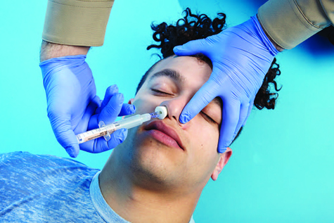
Intranasal Medications
Naloxone
  The most common technique for naloxone administration is via the intranasal route.
FIGURE 12-9 Some EMTs may administer naloxone
intranasally to treat an opioid overdose.
© Jones & Bartlett Learning.
Notes:
Lecture Outline
D. Intranasal medications
1. Naloxone
a. The most common technique for naloxone administration is via the intranasal route.
b. The same considerations described for administering injectable naloxone apply here.
c. If naloxone is not available, bag-mask ventilations may be required.

Slide 44
Inhalation Medications (1 of 4)
Oxygen
  All cells need it to survive.
  Generally administered via:
    Nonrebreathing mask
    Nasal cannula
Notes:
Lecture Outline
E. Inhalation medications
1. Oxygen
a. By far the most commonly administered medication in the prehospital setting
b. All cells, especially those in the heart and brain, need oxygen to function properly.
c. Generally administered:
i. Via a nonrebreathing mask at 10 to 15 L/min
ii. Via nasal cannula at 2 to 6 L/min
d. Must also provide artificial ventilations if the patient is not breathing (using a bag-mask device at 15 L/min)
e. Ensure that there are no open flames, lit cigarettes, or sparks in the area in which you are administering oxygen.

Slide 45
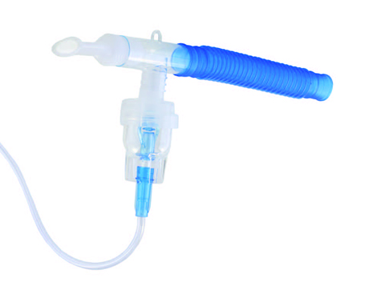
Inhalation Medications (2 of 4)
MDIs and nebulizers
  Liquid turned into mist or spray
  Medication breathed in and delivered to alveoli
  Fast absorption rate
  Easy route to access
  Portable
FIGURE 12-10 Metered-dose inhalers and small-volume nebulizers (shown here) convert liquid medications into a fine mist.
© Charles Brutlag/Shutterstock.
Notes:
Lecture Outline
2. Metered-dose inhalers and nebulizers
a. Used to administer liquid medications that have been turned into a fine mist by a flow of air or oxygen
b. Medication is atomized, breathed into the lungs, and delivered to the alveoli
c. Advantages
i. Fast and relatively easy route to access.
d. Disadvantages
i. Patient needs to be cooperative and control breathing
ii. Cannot be used for unconscious patients
3. Medications administered using an MDI or small-volume nebulizer (SVN)
a. An MDI requires a great deal of coordination to administer.
i. May be difficult to achieve when a person is having trouble breathing

Slide 46
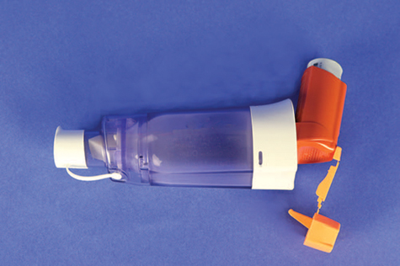
Inhalation Medications (3 of 4)
Use a spacer to avoid spray misdirection
  Fits over the inhaler like a sleeve
  Patient sprays the prescribed dose into the chamber and then breathes in and out of the mouthpiece.
  Especially useful with young children
FIGURE 12-11 Some inhalers have spacer devices to better direct the medication spray.
© Jones & Bartlett Learning.
Notes:
Lecture Outline
b. Use a spacer (adapter) to avoid spray misdirection.
i. A spacer fits over the inhaler like a sleeve.
ii. A spacer has an opening for the inhaler at one end and a mouthpiece on the other end.
iii. The patient sprays the prescribed dose into the chamber and then breathes in and out of the mouthpiece until the mist is completely inhaled.
iv. Spacer devices are especially useful with young children who have difficulty using an MDI.

Slide 47
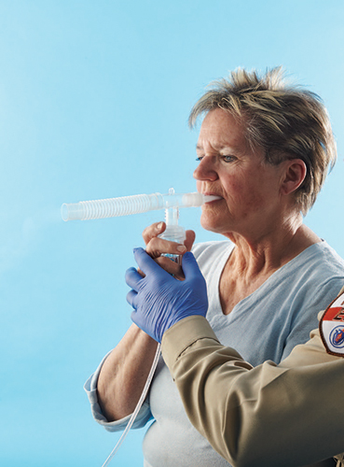
Inhalation Medications (4 of 4)
Small-volume nebulizers
  Easier to use than MDIs
  Take longer to deliver medication
  Require an external air or oxygen source
  More effective in patients with moderate to severe respiratory distress
  Can be used while a patient is on CPAP and during bag-mask ventilation
FIGURE 12-12 With a small-volume nebulizer, liquid medication is atomized by the flow of oxygen. The patient then breathes in the medication.
© Jones & Bartlett Learning.
Notes:
Lecture Outline
c. SVNs are much easier to use than MDIs.
i. Take longer to deliver the medication
ii. Require an external air or oxygen source
iii. Can be more effective than an MDI in patients with moderate to severe respiratory distress.
iv. Can be used while a patient is on CPAP and during bag-mask ventilation
v. Can be easily adapted to a nonrebreathing mask

Slide 48
Patient Medications (1 of 2)
Patient assessment includes finding out which medications the patient is taking.
  Provides vital clues to the patient’s condition
  Guides treatment
  Will be useful to the emergency department
Notes:
Lecture Outline
VII. Patient Medications
A. Patient assessment includes finding out which medications the patient is currently taking.
B. This information may provide vital clues to the patient’s condition.
1. May help guide your treatment
2. May be extremely useful to the emergency department physician
3. Can help you determine a chronic or underlying condition when a patient is unable to relate his or her medical history
C. Discover what the patient takes and transport the medications or a list of them with the patient to the emergency department.
D. Ask about use of any nonprescription drugs (eg, OTC, herbal, or illegal drugs).

Slide 49
Patient Medications (2 of 2)
Do not underestimate the importance of obtaining a thorough medication history.
Medications are often not taken as prescribed.
Medications may alter the clinical presentation.
Notes:
Lecture Outline
E. Implications for EMS Providers
1. Do not underestimate the importance of obtaining a thorough medication history.
2. Medications are frequently not taken as prescribed.
3. Consider a patient’s medication in the context of the clinical encounter.
4. Patient medications may significantly alter the clinical presentation of many acute medical conditions or injuries.
a. Beta adrenergic blocking agents
b. Calcium channel blockers
c. Antiplatelet and anticoagulant medications

Slide 50
Medication Errors (1 of 2)
Inappropriate use of a medication that could lead to patient harm
May be possible to minimize errors if circumstances are understood
Ensure the environment does not contribute to errors.
Notes:
Lecture Outline
VIII. Medication Errors
A. A medication error is inappropriate use of a medication that could lead to patient harm.
B. Ensure that the environment does not contribute to errors.
1. Ensure lighting is sufficient.
2. Organize equipment.
3. Limit distractions as much as possible.
4. Consider using a “cheat sheet” to help yourself remember all crucial steps to medication administration.

Slide 51
Medication Errors (2 of 2)
If a medication error occurs:
  Provide appropriate patient care.
  Notify medical control.
  Follow protocols.
  Document thoroughly, accurately, and honestly.
  Talk with your partner, supervisor, or medical director.
Notes:
Lecture Outline
D. If a medication error does take place:
1. Rapidly provide any appropriate patient care that is required.
2. Notify medical control as quickly as possible.
3. Follow your local protocols.
4. Document the incident thoroughly, accurately, and honestly.
5. Talk with your partner, supervisor, or medical director.
a. Opportunities to learn
b. Identify areas to target during quality improvement

Slide 52
Review
Pharmacology is defined as the:
  study of cells and tissues.
  study of drugs and medications.
  effects of medications in the lungs.
  distribution of drugs to the body’s tissues.

Slide 53
Review
Answer: B
Rationale: Pharmacology is the field of science that deals with the study of drugs and medications.

Slide 54
Review
Pharmacology is defined as the:
  study of cells and tissues.
  Rationale: This is physiology, which is a branch of biology.
  study of drugs and medications.
  Rationale: Correct answer
  effects of medications in the lungs.
  Rationale: This is pharmacodynamics, which includes the processes of the body’s response to medications.
  distribution of drugs to the body’s tissues.
  Rationale: This is pharmacokinetics, which studies medication distribution within the body.

Slide 55
Review
Which of the following statements regarding medications is FALSE?
  Many medications are known by different names.
  Some medications affect more than one body system.
  Over-the-counter drugs must be prescribed by a physician.
  EMTs should ask about any herbal remedies or vitamins that the patient may be taking.

Slide 56
Review
Answer: C
Rationale: Over-the-counter (OTC) drugs, such as aspirin, Tylenol, and Motrin, do not require a physician prescription. They can be purchased at a supermarket or drugstore. Most medications have a generic name and a trade name. For example, acetaminophen is the generic name for Tylenol, and ibuprofen is the generic name for Motrin.

Slide 57
Review
Which of the following statements regarding medications is FALSE?
  Many medications are known by different names.
  Rationale: True; medications can have several different names.
  Some medications affect more than one body system.
  Rationale: True; medications can affect many different body systems.
  Over-the-counter drugs must be prescribed by a physician.
  Rationale: Correct answer
  EMTs should ask about any herbal remedies or vitamins that the patient may be taking.
  Rationale: True; herbal remedies and vitamins can have interactions and effects on the patient’s health and condition.

Slide 58
Review
Which of the following routes of medication administration has the fastest effect?
  Oral
  Intravenous
  Subcutaneous
  Intramuscular

Slide 59
Review
Answer: B
Rationale: Because its administration is directly into a vein, a drug given intravenously enters the body quickly. The intravenous route is the fastest acting of all the routes of medication administration.

Slide 60
Review
Which of the following routes of medication administration has the fastest effect?
  Oral
  Rationale: The medication must be absorbed through the mucous membranes first to get to the circulatory system.
  Intravenous
  Rationale: Correct answer
  Subcutaneous
  Rationale: The medication must pass through the layers of skin before reaching the circulatory system.
  Intramuscular
  Rationale: The medication needs to travel to the circulatory system.

Slide 61
Review
When administered to a patient, a metered-dose inhaler will:
  deliver the same dose each time it is administered.
  be ineffective when given to patients with asthma.
  deliver a different dose each time it is administered.
  be delivered to the lungs over a period of 6 to 8 hours.

Slide 62
Review
Answer: A
Rationale: The metered-dose inhaler (MDI) delivers the same dose of medication each time it is used. Drugs given via the MDI act very quickly and are commonly prescribed to patients with asthma, emphysema, and other airway diseases.

Slide 63
Review
When administered to a patient, a metered-dose inhaler will:
  deliver the same dose each time it is administered.
  Rationale: Correct answer
  be ineffective when given to patients with asthma.
  Rationale: An inhaler is usually prescribed for patients with asthma.
  deliver a different dose each time it is administered.
  Rationale: An inhaler is metered to deliver the same dose every time.
  be delivered to the lungs over a period of 6 to 8 hours.
  Rationale: The medication is delivered straight to the lungs, almost immediately, because it is inhaled.

Slide 64
Review
You are managing a 62-year-old woman who complains of crushing chest pain. Her blood pressure is 84/64 mm Hg, and her heart rate is 110 beats/min. Medical control advises you to assist her in taking her prescribed nitroglycerin. After receiving this order, you should:
  reassess the patient’s heart rate and then assist with the nitroglycerin.
  repeat the patient’s blood pressure to the physician and confirm the order.
  wait 10 minutes, reassess the blood pressure, and then give the nitroglycerin.
  administer the nitroglycerin to the patient and then reassess her blood pressure.

Slide 65
Review
Answer: B
Rationale: Nitroglycerin is a vasodilator and lowers blood pressure (BP); therefore, it should not be given to patients with a systolic BP less than 100 mm Hg. If you receive an order to give nitroglycerin to a patient with a systolic BP less than 100 mm Hg, you should ensure that the physician is aware of the patient’s BP, then reconfirm the order.

Slide 66
Review (1 of 2)
You are managing a 62-year-old woman who complains of crushing chest pain. Her blood pressure is 84/64 mm Hg, and her heart rate is 110 beats/min. Medical control advises you to assist her in taking her prescribed nitroglycerin. After receiving this order, you should:
  reassess the patient’s heart rate and then assist with the nitroglycerin.
  Rationale: Administration of nitroglycerin is based on the patient’s blood pressure, not on the patient’s heart rate.
  repeat the patient’s blood pressure to the physician and confirm the order.
  Rationale: Correct answer

Slide 67
Review (2 of 2)
You are managing a 62-year-old woman who complains of crushing chest pain. Her blood pressure is 84/64 mm Hg, and her heart rate is 110 beats/min. Medical control advises you to assist her in taking her prescribed nitroglycerin. After receiving this order, you should:
  wait 10 minutes, reassess the blood pressure, and then give the nitroglycerin.
  Rationale: You should ensure that the physician is aware of the patient’s blood pressure and then reconfirm the order.
  administer the nitroglycerin to the patient and then reassess her blood pressure.
  Rationale: Nitroglycerin is a vasodilator and lowers the patient’s blood pressure. This medication should not be given to patients with a systolic blood pressure less than 100 mm Hg.

Slide 68
Review
Activated charcoal is indicated for patients who have ingested certain drugs and toxins because it:
  acts as a direct reversal agent for most medications.
  induces vomiting before the chemical can be digested.
  detoxifies the drug before it can cause harm to the patient.
  binds to chemicals in the stomach and delays absorption.

Slide 69
Review
Answer: D
Rationale: Activated charcoal is an adsorbent—that is, it binds to harmful chemicals that have been ingested. This binding effect delays digestion and absorption of the chemical by the body.

Slide 70
Review
Activated charcoal is indicated for patients who have ingested certain drugs and toxins because it:
  acts as a direct reversal agent for most medications.
  Rationale: Activated charcoal binds with chemicals.
  induces vomiting before the chemical can be digested.
  Rationale: Activated charcoal is not the medication used to induce vomiting.
  detoxifies the drug before it can cause harm to the patient.
  Rationale: Activated charcoal binds with chemicals, delays absorption, and helps in getting chemicals through the digestive system.
  binds to chemicals in the stomach and delays absorption.
  Rationale: Correct answer

Slide 71
Review
With regard to pharmacology, the term “action” refers to the:
  ability of a drug to cause harm.
  ability of a drug to produce side effects.
  amount of time it will take the drug to work.
  expected effect of a drug on the patient’s body.

Slide 72
Review
Answer: D
Rationale: As it applies to pharmacology, the term “action” refers to the effect that a drug is expected to have on a patient’s body. Prior to administering any drug, the EMT must be aware of its action(s) on the body.

Slide 73
Review
With regard to pharmacology, the term “action” refers to the:
  ability of a drug to cause harm.
  Rationale: This is called a contraindication.
  ability of a drug to produce side effects.
  Rationale: This is any action of a medication other than the desired ones.
  amount of time it will take the drug to work.
  Rationale: This is the onset of action.
  expected effect of a drug on the patient’s body.
  Rationale: Correct answer

Slide 74
Review
Which of the following patients is the BEST candidate for oral glucose?
  Conscious patient who is showing signs of hypoglycemia
  Unconscious diabetic patient with a documented low blood sugar
  Conscious diabetic patient suspected of being hyperglycemic
  Semiconscious patient with signs and symptoms of low blood sugar

Slide 75
Review
Answer: A
Rationale: Oral glucose is given to diabetic patients with suspected or documented hypoglycemia (low blood sugar). It should not be given to unconscious patients or those who are otherwise unable to swallow because it may be aspirated into the lungs.

Slide 76
Review
Which of the following patients is the BEST candidate for oral glucose?
  Conscious patient who is showing signs of hypoglycemia
  Rationale: Correct answer
  Unconscious diabetic patient with a documented low blood sugar
  Rationale: Oral glucose should not be given to unconscious patients.
  Conscious diabetic patient suspected of being hyperglycemic
  Rationale: Oral glucose is used for the treatment of hypoglycemia (low blood sugar).
  Semiconscious patient with signs and symptoms of low blood sugar
  Rationale: Oral glucose should not be given to those patients who are unable or may become unable to swallow.

Slide 77
Review
Epinephrine is given to patients with anaphylactic shock because of its effects of:
  bronchodilation and vasodilation.
  bronchodilation and vasoconstriction.
  vasodilation and bronchoconstriction.
  bronchoconstriction and vasoconstriction.

Slide 78
Review
Answer: B
Rationale: The two major complications associated with anaphylactic shock are bronchoconstriction, which impairs air movement in and out of the lungs, and vasodilation, which causes a drop in blood pressure. Epinephrine reverses these processes by causing bronchodilation and vasoconstriction, thereby improving breathing and increasing the blood pressure, respectively.

Slide 79
Review
Epinephrine is given to patients with anaphylactic shock because of its effects of:
  bronchodilation and vasodilation.
  Rationale: Epinephrine dilates the bronchi but constricts the circulatory system.
  bronchodilation and vasoconstriction.
  Rationale: Correct answer
  vasodilation and bronchoconstriction.
  Rationale: Epinephrine constricts the circulatory system and dilates the bronchi.
  bronchoconstriction and vasoconstriction.
  Rationale: Epinephrine dilates the bronchi and constricts the circulatory system.

Slide 80
Review
The process by which medications travel through body tissues until they reach the bloodstream is called:
  adsorption.
  onset of action.
  absorption.
  transformation.

Slide 81
Review
Answer: C
Rationale: The process by which medications travel through body tissues until they reach the bloodstream is called absorption. Adsorption refers to the binding of one chemical to another. Activated charcoal, for example, delays absorption of certain chemicals into the bloodstream because it adsorbs (binds to) them in the stomach.

Slide 82
Review
The process by which medications travel through body tissues until they reach the bloodstream is called:
  adsorption.
  Rationale: In adsorption, particles bind to a surface.
  onset of action.
  Rationale: Onset of action is the time that it takes for a medication to start doing what it is prescribed for.
  absorption.
  Rationale: Correct answer
  transformation.
  Rationale: This has nothing to do with medication administration.

